Slide 1
Setting up your Apiary

Slide 2
5 Considerations in Setting up Your Apiary
1. Easy Access for the beekeeper – convenient and easy footing
2. Protective cover from prevailing winds
3. Good Air Flow – avoid sites that are in hollows or damp ground
4. Keep away from heavy tree canopy
5. Don’t have your hives overlooking paths and roads – could be a
nuisance to anyone using them.

Slide 3
Other Consideration
1. How visible will your hives be to the public
2. Is there live stock in the area? Cattle and horses may rub on them and knock them over. If this is the best location, you will want to construct a fence around your Apiary
3. Is it likely that pesticides will be used? – under a powerline?

Slide 4
Location
Backyard Apiary – keeping bees in your backyard is convenient and provides entertainment and a connection with your environment.
Rural verses Urban – surprisingly bees do very well in cities and suburbs. I live in the country and have my bees about 300 yards away from my house.
Remote Apiary – many beekeepers keep their hives in out-yards located away from their own homes.

Slide 5
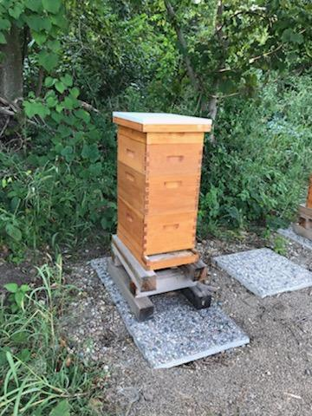
Photos of various Apiaries Hives on blocks Landscape timbers Recycled sidewalk & Block

Slide 6
Design of hive stands

Slide 7
Other Important Factors
Hive should be facing South to Southeast - Opening facing morning sun and away from the wind and Rain.
Height of the bottom board from the ground – I recommend the hive to be approximately 18 inches off the ground.
Distance between hives – generally 2 feet apart reduces the risk of drifting and to allow easy access for inspection
Area around the hives – you will need an area that is free from debris and level to prevent tripping and increase ease to manager your bee hives.

Slide 8
Water Source
Farm/country land often have many sources of water nearby, streams, creeks, pond within 400 to 600 meters. Birdbaths, chicken waterers, etc. are also good sources to provide clean water to your bees.
Note for urban beekeeping – if you don’t provide nearby water, they can be a nuisance at all nearby pools.
Bees can drown easily, so you may want to add corks, sticks, marbles or rocks, in your water source.

Slide 9
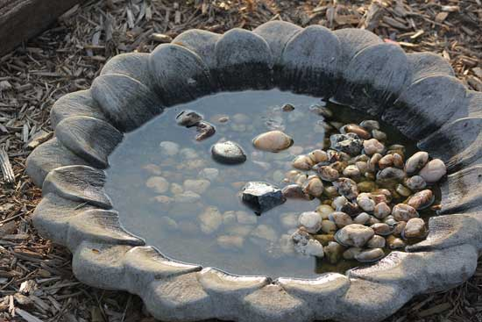
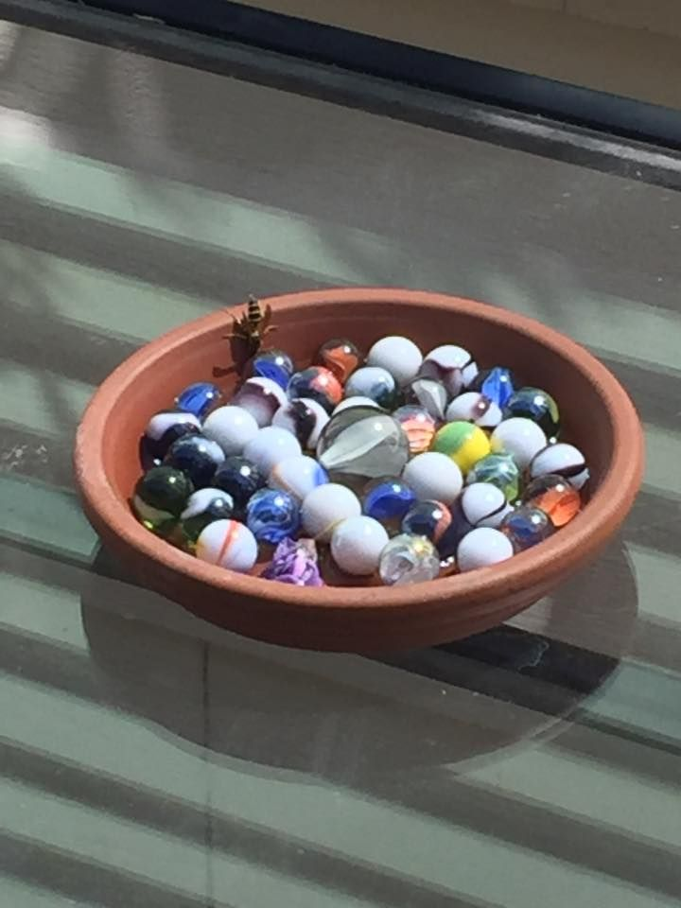
Water Feeders

Slide 10
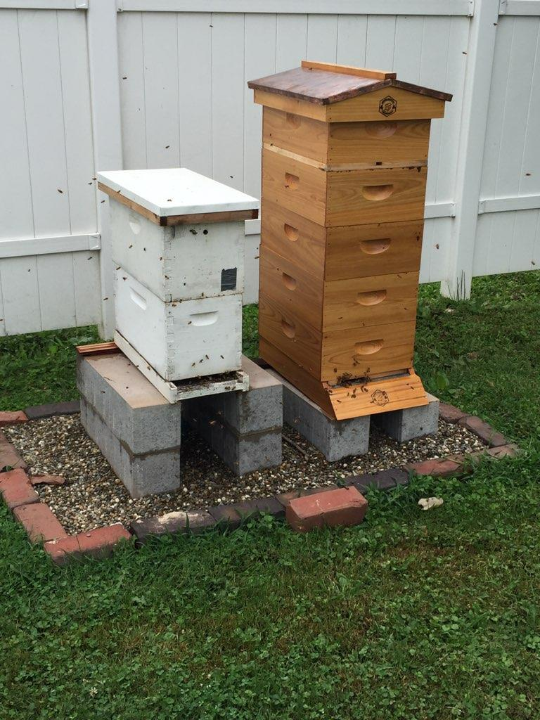
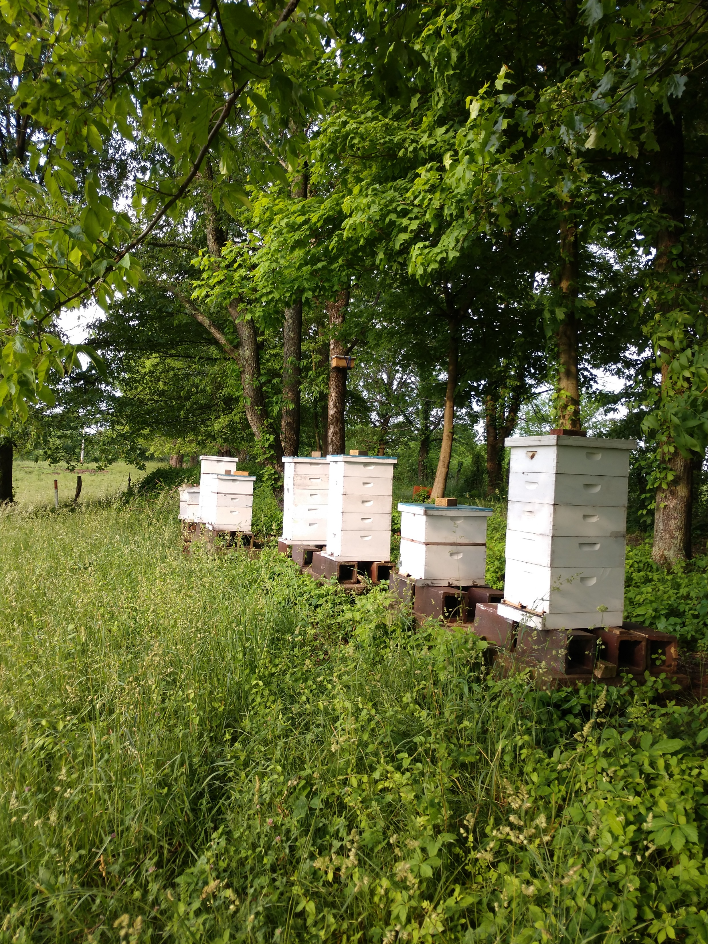
Photos of Apiaries

Slide 11
Being a Good Neighbor
To help soothe tempers nearby, maintain a gentle stock of bees.
If your colonies are near a neighbor property line, erect a six foot barricade between the bees and the line. Anytime bees are flying close to the ground and across the property line of a neighbor, there are potential problems.
Don’ work your bees when neighbors are in their yard.
A pound or two of free honey bordering your property often makes bees much more acceptable.

