Slide 1
Introduction to Beekeeping for Beginners
Presented by Guernsey Noble Beekeepers
www.guernseynoblebeekeepers.com

Slide 2
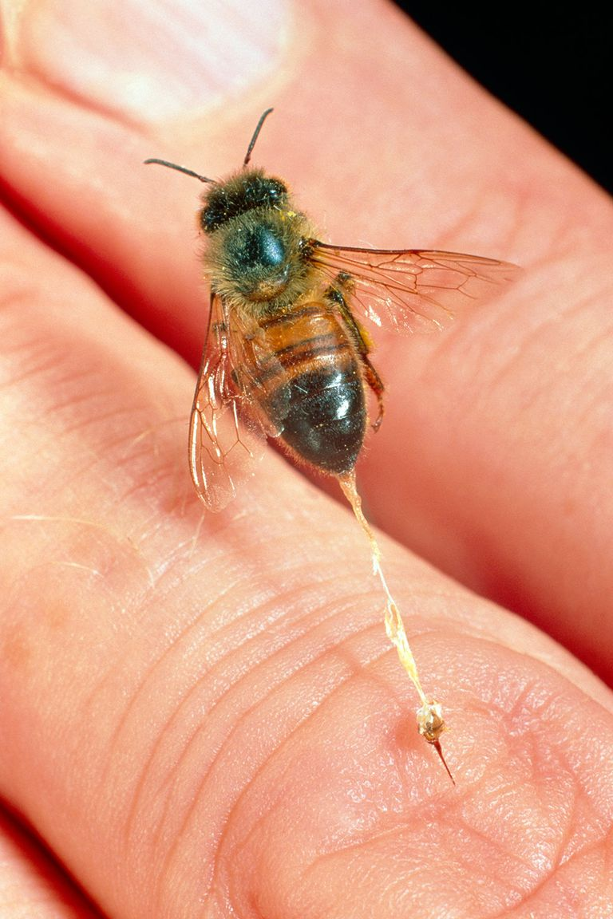
Fear of Bee Stings:
1. You can dress to reduce the Chance of being “Stung”
2. The bee sting is a defensive behavior of honey bees.
Most often, it is used in the defense of the hive.

Slide 3
Honey Bees can be aggressive:
  During Bad Weather
  Being harassed by Skunks
  Protecting their honey during a dearth (Aug-Sept)
  Or genetics of the Queen can determine agressiveness

Slide 4
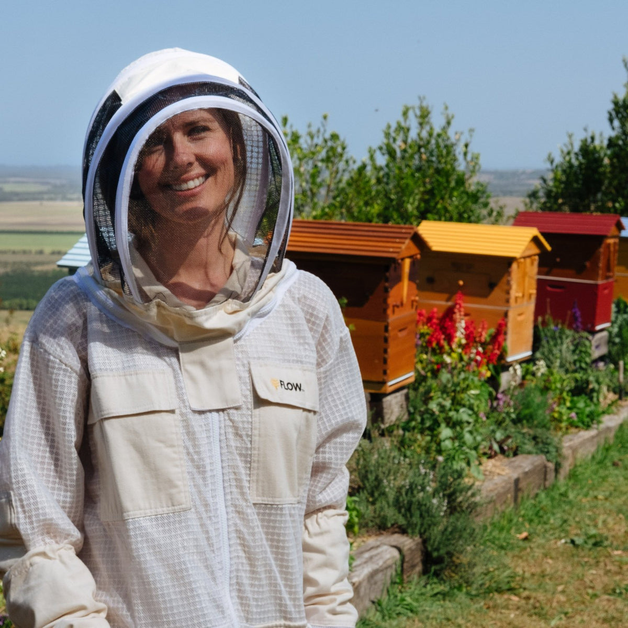
Recommendation for the New Beekeeper
  Jacket with an attached veil
  Gloves
  Protective Clothing
  Shoes

Slide 5
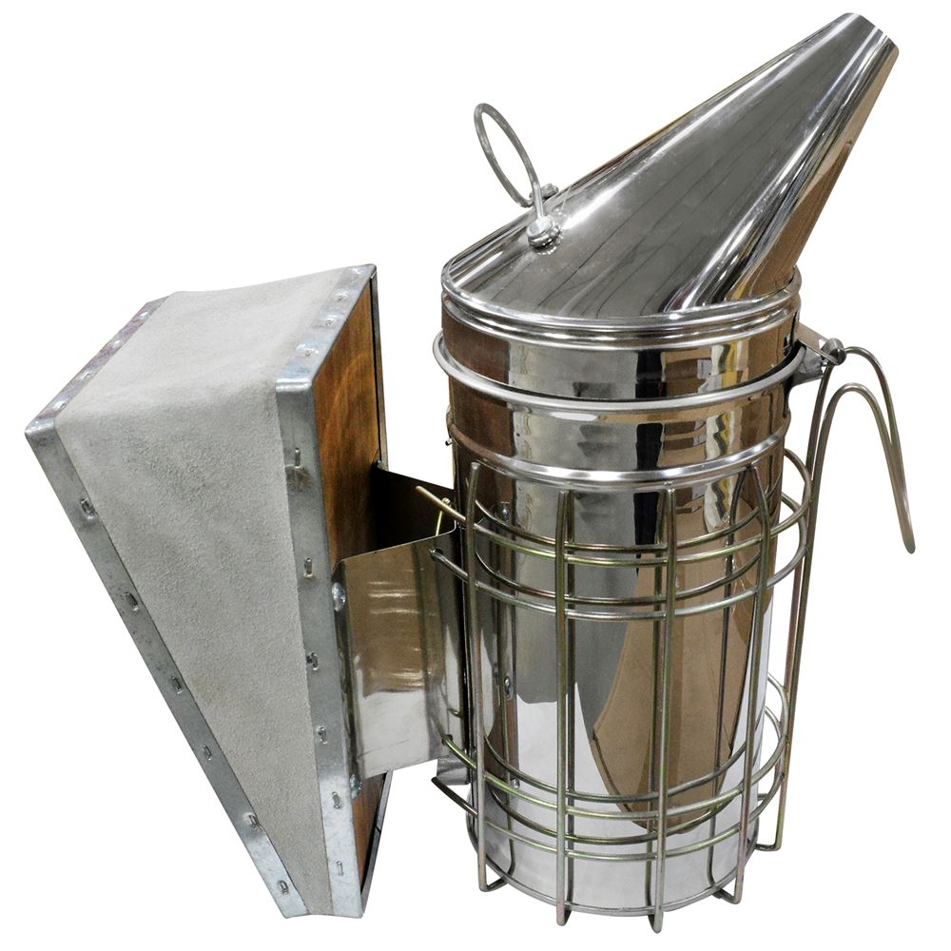
Smoke is used to control Bee behavior and thus is a vital tool for a beginner.

Slide 6
Honey Bee are important for:
  Pollination
  Honey
  Wax
  Propolis
  Royal Jelly
  Bee Stings for Apitherapy

Slide 7
What is needed for a good location?
Are there restrictions on uses of our property for placing hives on the property
Do you have a near-by water source? Caution neighbors with swimming pools or hot tubs
Do you rent – landlord permission
Do you have enough property and space to locate hives on your property.

Slide 8
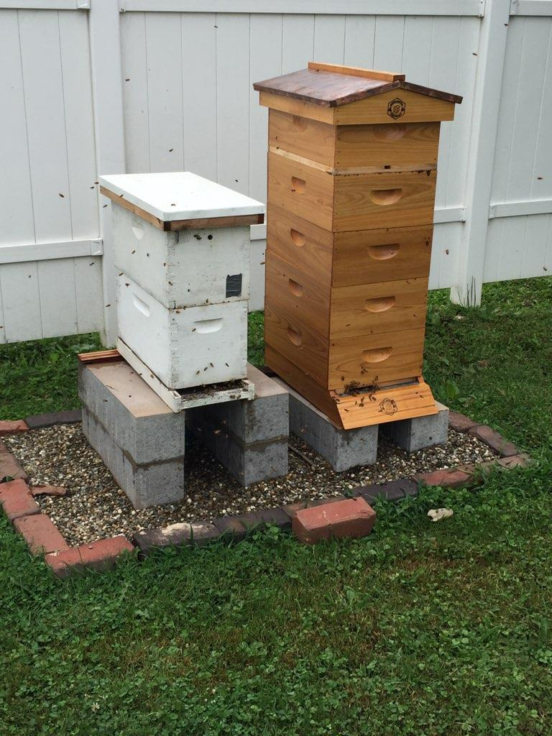
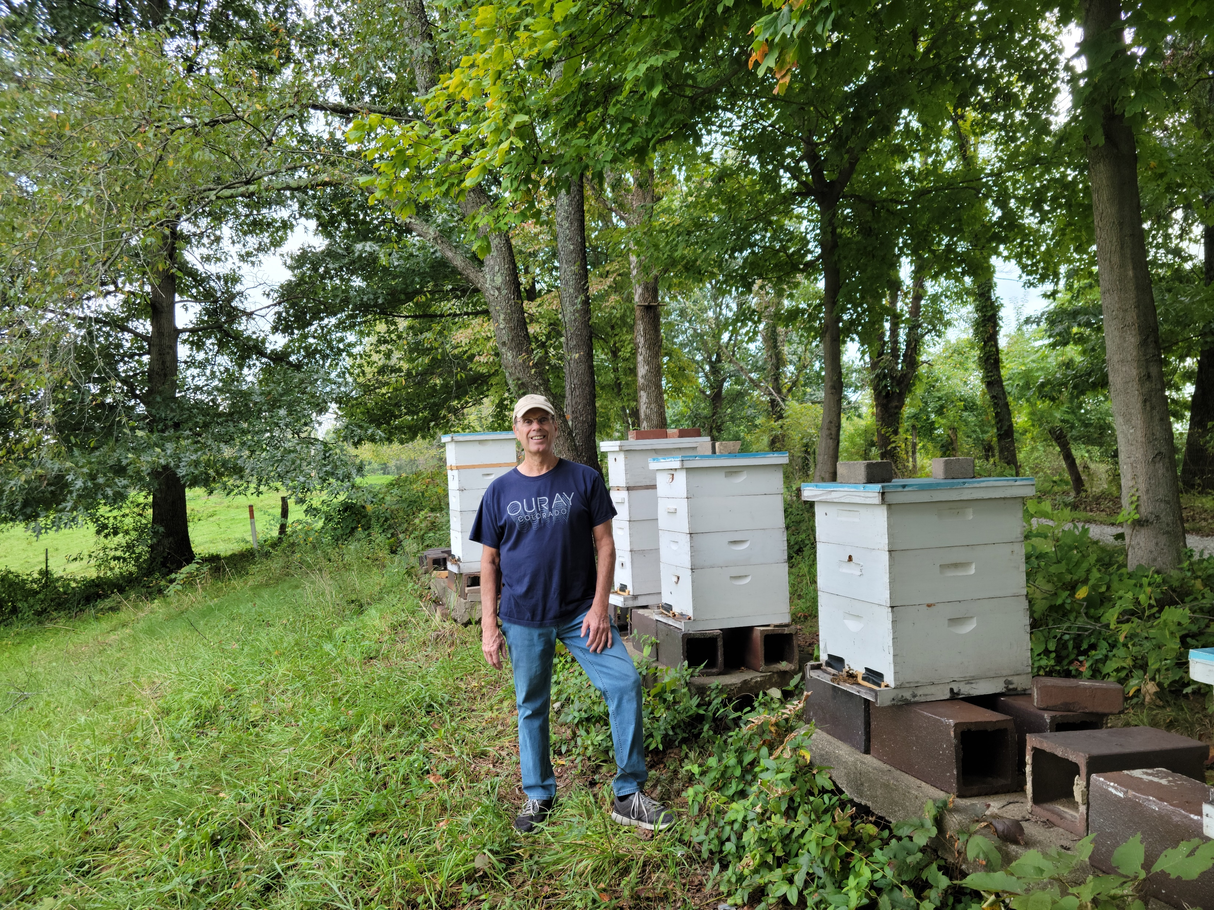

Slide 9
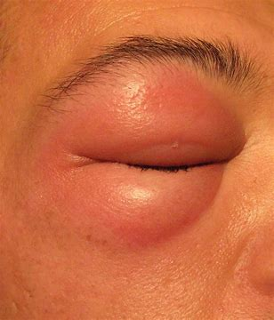
Other consideration: Does anyone in your family-household have allergic reactions to bee stings

