Slide 1
Basic Tools for the Beginning Beekeeper

Slide 2
Basic Tools
Jacket with a veil
Leather Gloves
Good Shoes
Loose fitting Pants (“No skinny Jeans”)
Smoker
Hive Tool
Brush

Slide 3
The Hive
8 Frame Hives verses 10 Frame Hives
  If I started now, I would have used the 8 frames (much lighter)
Bottom Board – solid or screen bottom
Hive Body – Deep box or medium box
Honey Supers – Medium Box – shallow
Inner Cover
Top Cover

Slide 4
Inside the Hive
Frames with wax foundation
or
Frames with plastic foundation & coated with wax
Queen Excluder – this is optional for beekeepers. I do not use the excluders.
Various types of feeders

Slide 5
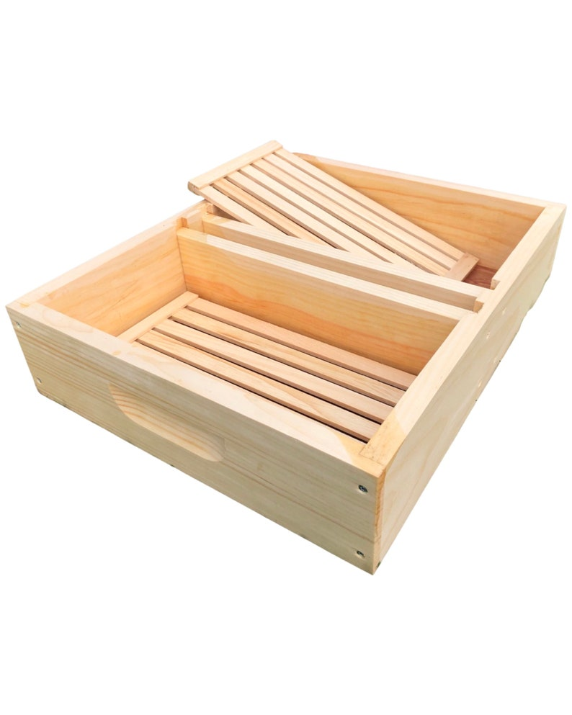
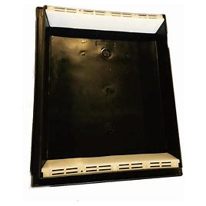
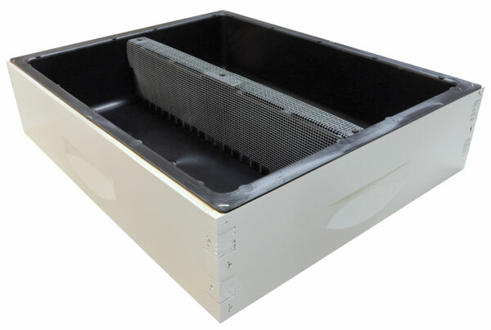
Top Feeders

Slide 6
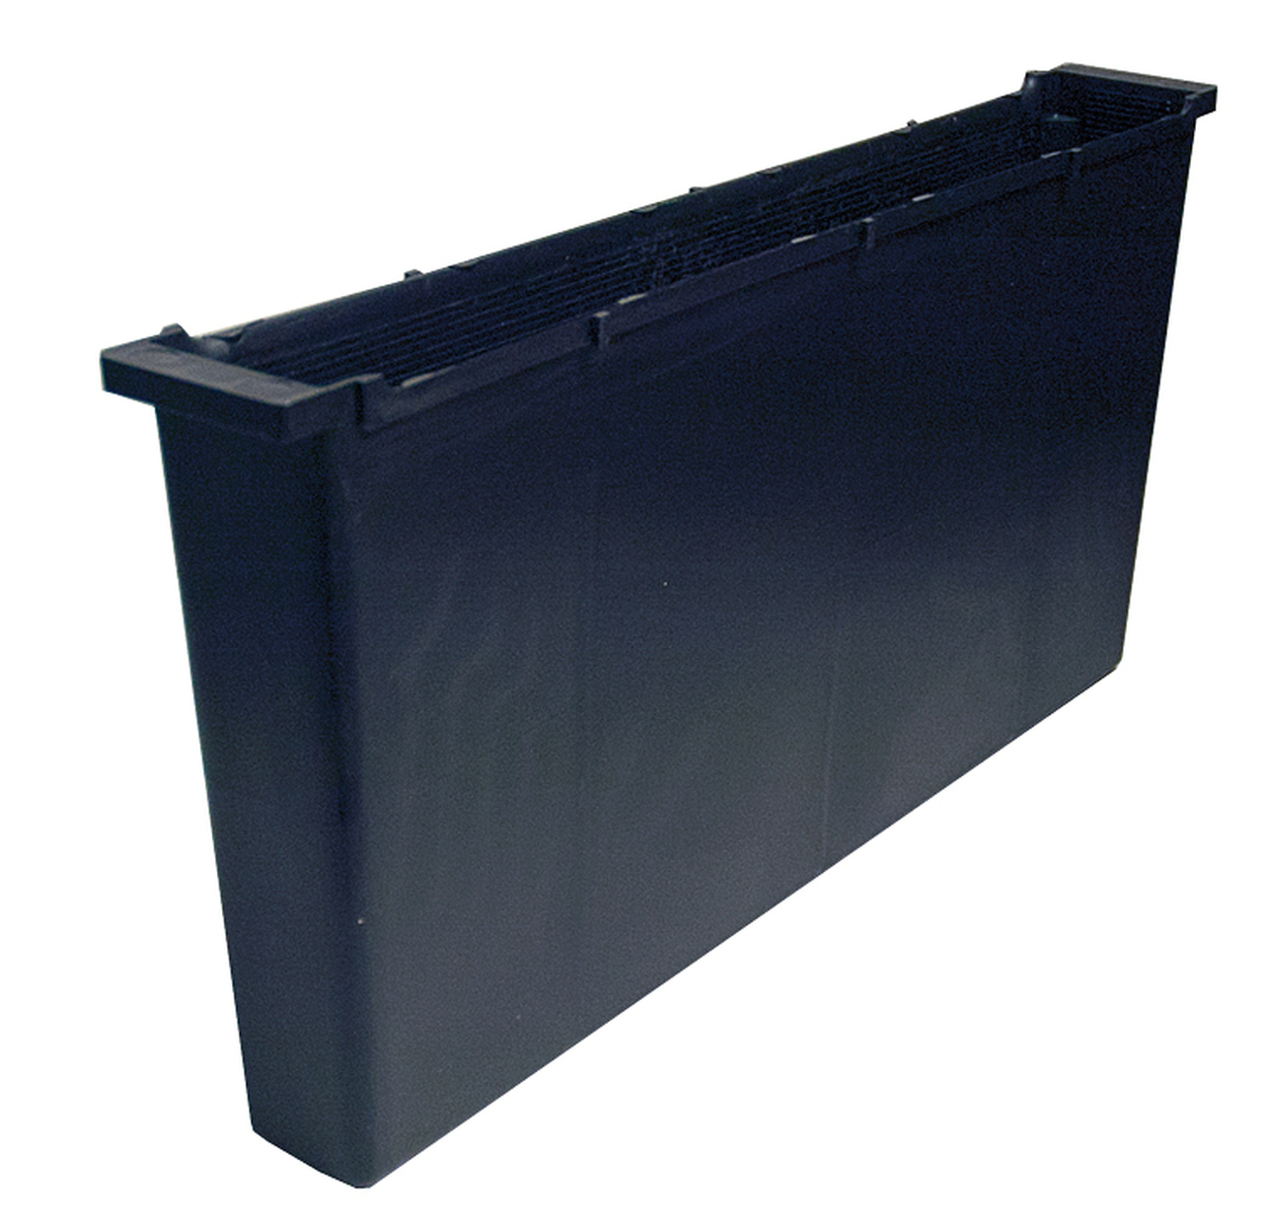
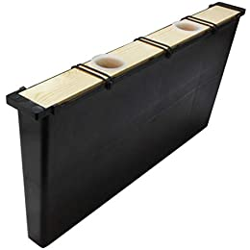
Frame Feeders

Slide 7
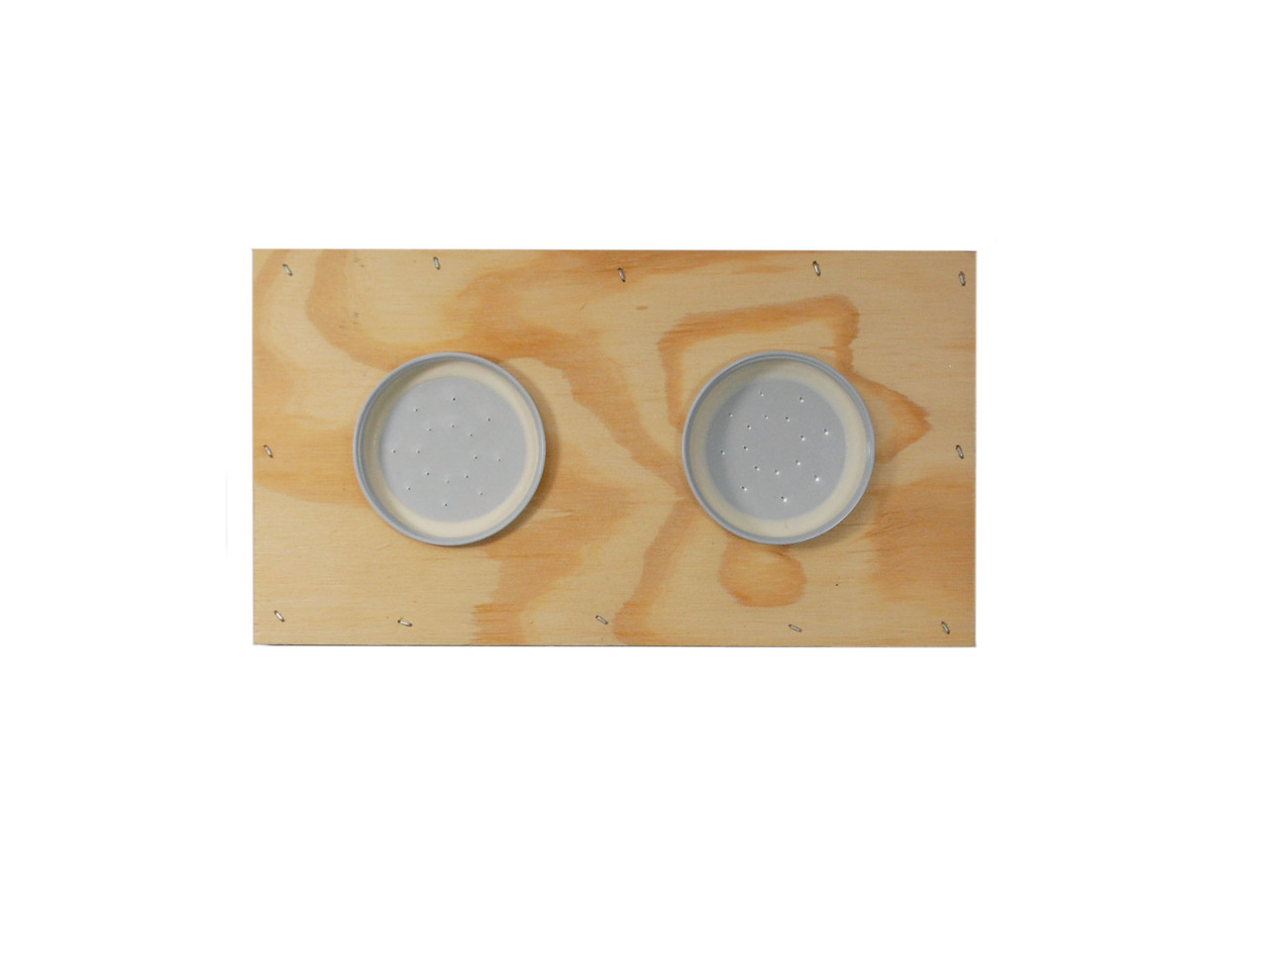
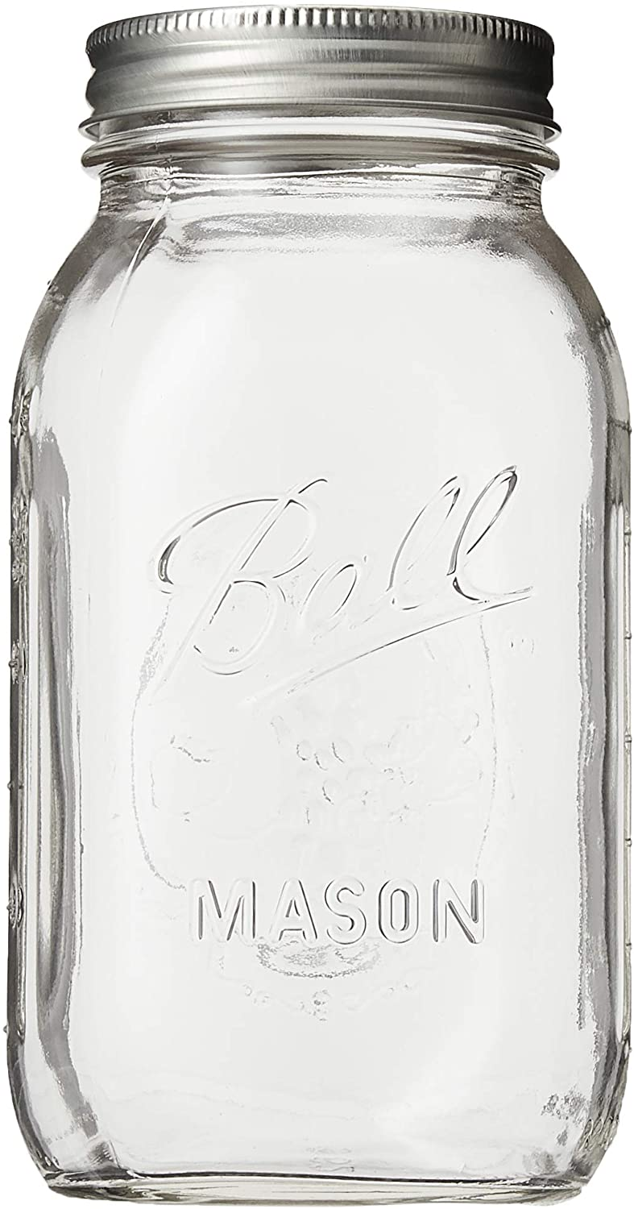
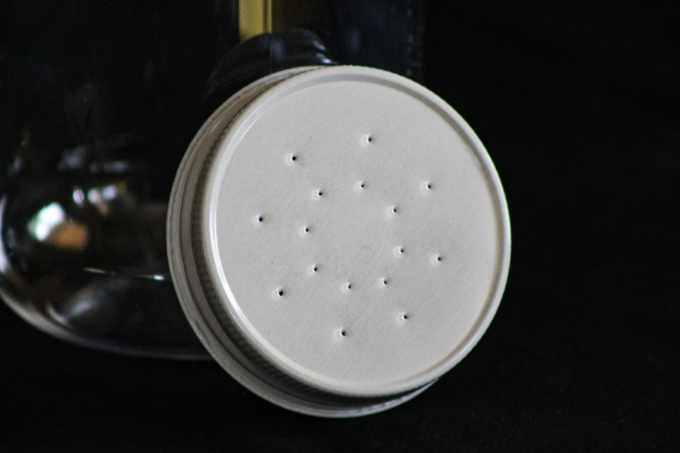
My favorite and at a Good Price

Slide 8
Where to buy equipment
Locally
www.thebeebarnohio.com The Bee Barn in Marietta
450 Coffman Rd, Marietta, 740-516-0421
www.bostlersbstuff.com Bosler’s Bee Stuff
S&S Bee Supply 9096 Bell Road, Adamsville, 740-630-5609
www.hiveandhoney.com Conrad Hive and Honey
6240 Wright Rd. Canal Winchester, 614-837-3899
Royal King and Orme and Other hardware stores have basic supplies

Slide 9
Catalog stores can be convenient
https://blueskybeesupply.com Blue Sky Bee Supply
930 N. Freedom St. Ravenna, Oh 44266 877-529-9233
Great to work with.
www.mannlakeltd.com Mann Lake Bee Supply
800-880-7694 (free shipping)
Large Supplier

